Slide 1
Practice Program 2: Breadth First Search & Depth First Search C Program Implementation.

Slide 2
What is BFS ?????
BFS stands for Breadth First Search.
BFS is an algorithm for traversing a tree or graph.
It uses a queue data structure for implementation.
In BFS traversal we visit all the nodes level by level and the traversal completed when all the nodes are visited.

Slide 3
Algorithm for BFS :
Step 1: Initialize all nodes with status=0.(ready state)
Step 2: Put starting node in a queue and change its
status to status=1.(waiting state).
Step 3: loop: Repeat, step 4 and step 5 until queue gets empty.
Step 4: Remove front node N from queue, and then display it.
Step 5: Add all the neighbors of N to the rear of queue
and change status to status=1.(waiting status)

Slide 4
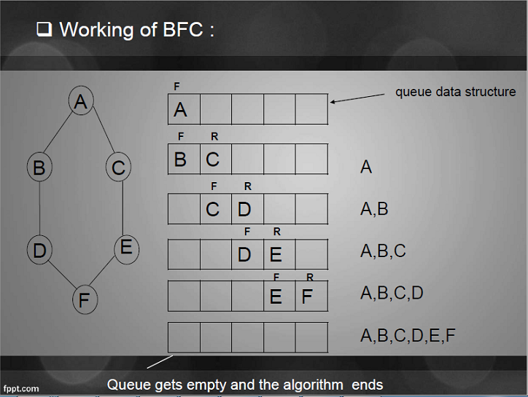
Working of BFS
S

Slide 5
What is DFS ?????
DFS stands for Depth First Search.
DFS is an algorithm for traversing tree or graph.
It uses a stack data structure for implementation.
In DFS, we start at the root and explore as far as possible along each branch before backtracking.

Slide 6
Algorithm of DFS
[1]. Initialize all nodes with status = 0.(ready state)
[2]. Put starting node in the stack and change status
to status=1(waiting state).
[3]. Loop:- Repeat step- 4 and step- 5 until stack gets
empty.
[4]. Remove top node N from stack and then display it.
[5]. Add all the neighbors of N to the top of stack and
change status to waiting status = 1.

Slide 7
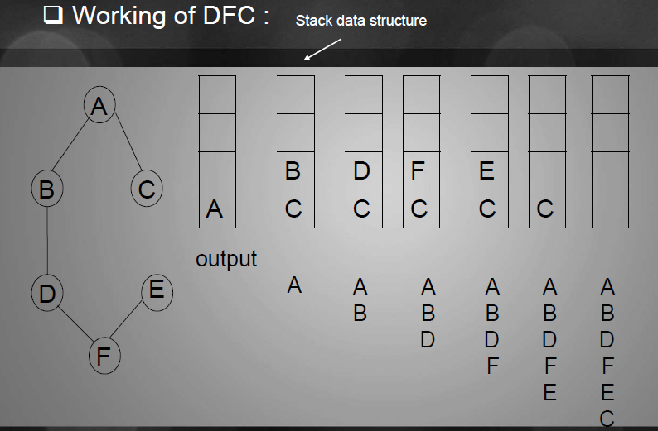
Working of DFS

Slide 8
/* Represent nodes of a graph by using numbers starting from 0 */
#include<stdio.h>
int top=-1, q[20], stack[20], front= -1 , rear= -1, arr[20][20], visited[20]={0};
main()
{
int i, j, n, ch, s;
printf("Enter the Number of Vertices\n");
scanf("%d",&n);
printf("Enter adjacency matrix ( 1 if there is an edge, otherwise 0) \n”);
for(i=0; i<=n-1; i++)
{
for(j=0; j<=n-1; j++)
{
scanf("%d",&arr[i][j]);
}
}

Slide 9
printf("Enter Choice 1.BFS 2.DFS \n");
scanf("%d",&ch);
printf("Enter starting vertex\n");
scanf("%d",&s);
switch(ch)
{
case 1: bfs(s,n); break;
case 2:dfs(s,n); break;
}
} // main end

Slide 10
bfs(int s, int n)
{
int i, p;
add(s);
visited[s]=1;
p=delete();
if(p!=0) printf("%d", p);
while(p != -1)
{
for(i=0; i<=n-1; i++)
{ if( (arr[p][i] !=0 ) && ( visited[i]==0) )
{ add(i);
visited[i]=1;
}
}
p=delete();
if(p != -1) printf("%d", p);
}
}

Slide 11
dfs(int s, int n)
{
int k, i;
push(s);
visited[s]=1;
k=pop();
if(k!=0) printf("%d",k);
while(k != -1)
{
for(i=0;i<=n-1;i++)
{
if( (arr[k][i] !=0 )&&( visited[i]==0) )
{
push(i);
visited[i]=1;
}
k=pop();
if(k != -1) printf("%d",&k);
}
}
}

Slide 12
void add(int item)
{
if(rear==19)
printf("QUEUE FULL");
else
{
if(rear == -1)
{
q[++rear] = item;
front++;
}
else
q[++rear]=item;
}
}

Slide 13
int delete()
{
int k;
if ((front > rear) || (front==-1) )
return ( -1 );
else
{
k=q[front++];
return(k);
}
}

Slide 14
void push( int item )
{
if ( top == 19 )
printf( "Stack overflow " );
else
stack[ ++top ] = item;
}
int pop()
{
int k;
if ( top == -1 ) return ( -1 );
else
{
k = stack[ top-- ];
return ( k );
}
}

